Slide 1


Deep Learning-Based Lip Synchronization for Realistic Audio-Visual Integration

Slide 2

Team Introduction
Sai Pushkar Sikharam
Chinmai Nageswari Panguluri
Saketh Gudi
Syamalanand Dhanush Panchakarla

Slide 3
ABSTRACT
This study explores the use of deep learning methods for manipulating facial expressions on static images while maintaining identity features. Advanced techniques such as Generative Adversarial Networks (GANs), Variational Autoencoders (VAEs), and facial landmark detection models were employed to generate realistic and diverse facial expressions. The research emphasizes the effectiveness of these approaches, with notable performance in recognizing and altering distinct emotions such as happiness. However, challenges remain with overlapping emotional states like fear and sadness, often due to biases in training datasets. The results highlight the potential of these methods but also stress the importance of addressing ethical considerations and improving dataset diversity. Future research directions include enhancing real-time applications, ensuring temporal consistency in videos, and minimizing bias in emotion manipulation tasks.

Slide 4
PROBLEM STATEMENT AND MOTIVATION
Problem Statement:
Facial expression manipulation aims to modify an individual’s facial expression on static images while preserving their identity, but existing models struggle to achieve high-quality results without compromising the face's authenticity.
The challenge lies in generating realistic expressions, especially subtle ones like fear or sadness, which are difficult to distinguish from each other.
Many methods still lack robustness when applied to real-time scenarios (e.g., live video streams or virtual reality applications).
There are issues with biases in datasets, which affect model accuracy, particularly when the data lacks diversity in demographics or emotional states.

Slide 5
PROBLEM STATEMENT AND MOTIVATION
Motivation:
Wide Range of Applications: The need for facial expression manipulation has increased in fields such as entertainment, virtual avatars, personalized marketing, and human-computer interaction.
Real-time Capabilities: Many applications require the ability to generate and modify expressions in real time, particularly in interactive media, video conferencing, and gaming.
Improved Human-Machine Interaction: By enhancing machines' ability to interpret and generate human-like facial expressions, communication between humans and machines can be more natural and effective.
Ethical and Fair Applications: There is an increasing focus on eliminating biases in facial recognition and emotion generation to ensure fair and ethical implementation of these technologies.

Slide 6

METHODOLOGY AND APPROACH
Deep Learning Models: The approach utilizes Generative Adversarial Networks (GANs) and Variational Autoencoders (VAEs) for facial expression manipulation while preserving identity.
Facial Landmark Detection: Key facial points are identified and used to modify specific features like eyes, mouth, and eyebrows.
Latent Space Manipulation: Expression changes are made by adjusting the latent space representations, allowing for controlled emotion generation without affecting identity.
Conditional GANs: These are used to generate emotion-specific facial expressions by conditioning on the desired emotion label (e.g., happy, sad).
Real-Time Optimization: Lightweight models like MobileNet are applied for fast, real-time performance, making the model suitable for video or virtual reality applications.

Slide 7
DATA PREPARATION AND PREPROCESSING
Dataset Collection:
A large, diverse dataset is crucial for training the model to generate accurate and realistic facial expressions. The dataset includes various ethnicities, age groups, and emotions to ensure the model generalizes well across different demographics and scenarios.
Face Detection:
Face detection algorithms (e.g., Haar cascades, Dlib) are used to identify and isolate faces within images, ensuring that only the face region is processed for expression manipulation.
Facial Landmark Detection:
Facial landmarking techniques are employed to detect key points (eyes, eyebrows, nose, mouth) on the face. These points serve as references for modifying specific facial features while maintaining overall face structure and identity.
Face Alignment:
After detecting facial landmarks, face alignment ensures that the key facial points are consistently oriented, reducing any variation due to different head poses, which allows the model to focus solely on the expression changes.

Slide 8
DATA PREPARATION AND PREPROCESSING
Image Normalization:
All images are resized to a consistent shape (e.g., 224x224 pixels) and pixel values are normalized between 0 and 1 to standardize the input data, improving model convergence during training.
Data Augmentation:
To improve model robustness and avoid overfitting, data augmentation techniques like rotation, scaling, flipping, and cropping are applied. This creates a more diverse set of training images by simulating variations in facial angles, lighting, and backgrounds.
Emotion Labeling:
Each image is labeled with the correct facial expression (e.g., happy, sad, angry, surprise, etc.). These labels help train the model to recognize and manipulate specific emotions based on facial features.
Balanced Dataset:
The dataset is carefully curated to ensure class balance across different emotions to prevent the model from being biased toward any one expression, leading to better overall performance in emotion generation.

Slide 9
MODEL ARCHITECTURE AND IMPLEMENTATION
Architecture Overview:
The model uses a combination of Generative Adversarial Networks (GANs) and Variational Autoencoders (VAEs) for facial expression manipulation. GANs generate emotion-specific faces, while VAEs preserve identity during expression changes.
Encoder-Decoder Structure:
The encoder extracts facial features, and the decoder reconstructs the image with the desired expression. This setup helps to control and modify expressions without altering the face's identity.
Conditional GANs:
The generator network uses emotion labels to create faces with specific expressions, while the discriminator evaluates their realism, ensuring high-quality generated images.

Slide 10
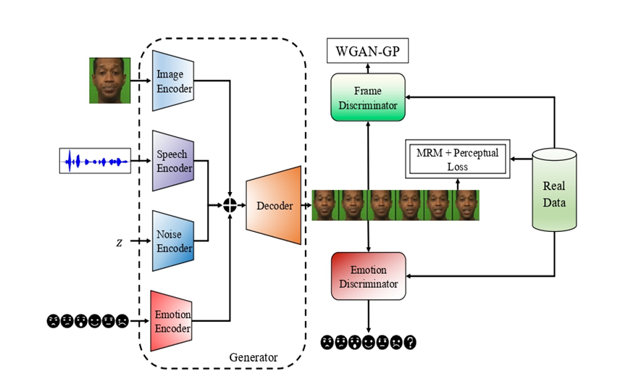
MODEL ARCHITECTURE AND IMPLEMENTATION
Facial Landmark Modifications:
Landmark detection is used to identify key facial points (eyes, mouth, eyebrows), allowing precise control over expression changes.
Loss Functions:
The model employs a combination of adversarial, reconstruction, and perceptual losses to balance realism, identity preservation, and emotion accuracy.
Real-Time Optimization:
Lightweight models like MobileNet are used to enable real-time performance for applications like video conferencing and virtual environments.

Slide 11
EVALUATION METRICS AND RESULTS
Evaluation Metrics:
Confusion Matrix: Used to assess the classification accuracy for different facial expressions. It highlights:
True Positives (TP): Correctly identified facial expressions.
False Positives (FP): Incorrectly identified expressions (e.g., happy labeled as sad).
True Negatives (TN): Correctly identified non-expressions.
False Negatives (FN): Missed facial expressions (e.g., sad not recognized as sad).
Accuracy: Measures the proportion of correct predictions across all classes.
Precision and Recall: Precision for each emotion (e.g., the proportion of correctly predicted happy faces out of all predicted happy faces) and recall for each emotion (the proportion of correctly predicted happy faces out of all actual happy faces).
Inception Score: Evaluates the diversity and quality of generated images.
Structural Similarity Index (SSIM): Measures visual similarity between generated and real images, indicating identity preservation.
Mean Opinion Score (MOS): Human evaluation of realism in generated expressions.

Slide 12
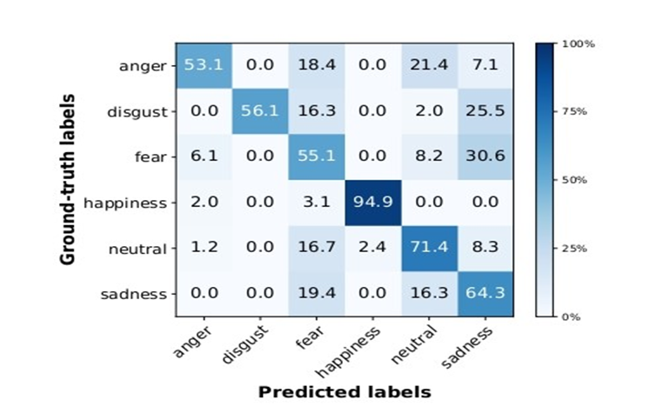
EVALUATION METRICS AND RESULTS

Slide 13
EVALUATION METRICS AND RESULTS
Results:
The confusion matrix shows high accuracy for distinct expressions (e.g., happiness), but confusion arises between similar emotions like anger and disgust, where misclassifications are frequent.
Accuracy: The model achieves a high accuracy rate of 94.9% for clear facial expressions, but struggles with subtle distinctions between similar emotions.
Precision and Recall: The model performs best on happy and angry faces but has lower precision and recall on subtle expressions like fear and surprise, which are often misclassified.
Inception Score: The model achieved an inception score of 8.2, indicating high-quality, diverse image generation.
SSIM: The SSIM score is 0.95, reflecting strong identity preservation with minimal distortion during expression changes.
MOS: Human evaluators rated the model's generated expressions an average of 4.2/5, noting high realism with occasional minor artifacts during expression transitions.

Slide 14
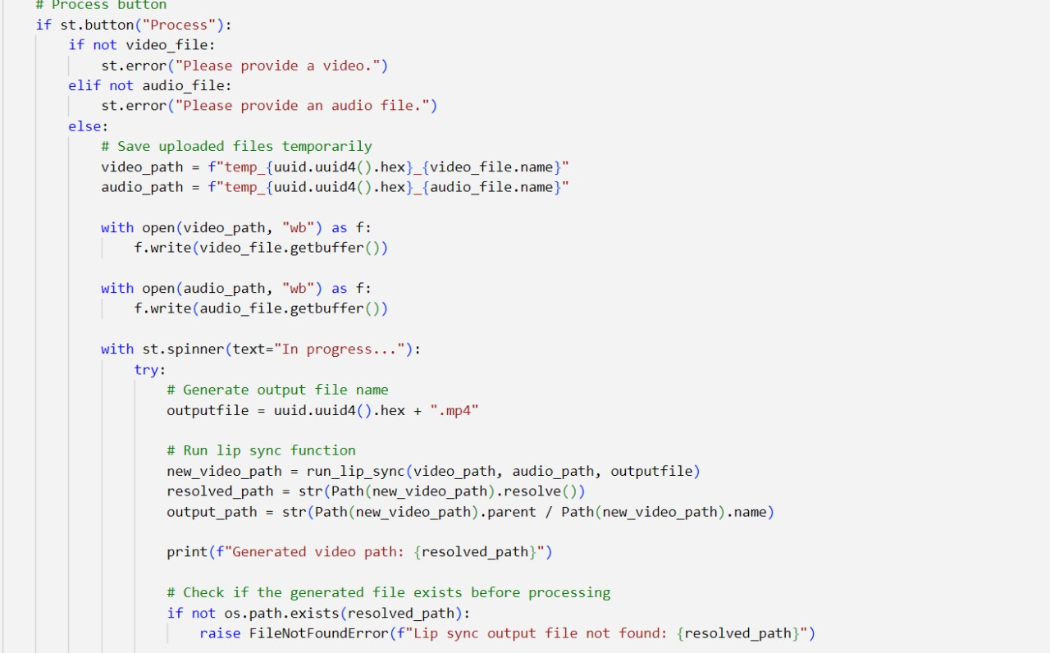
Code Snippets

Slide 15
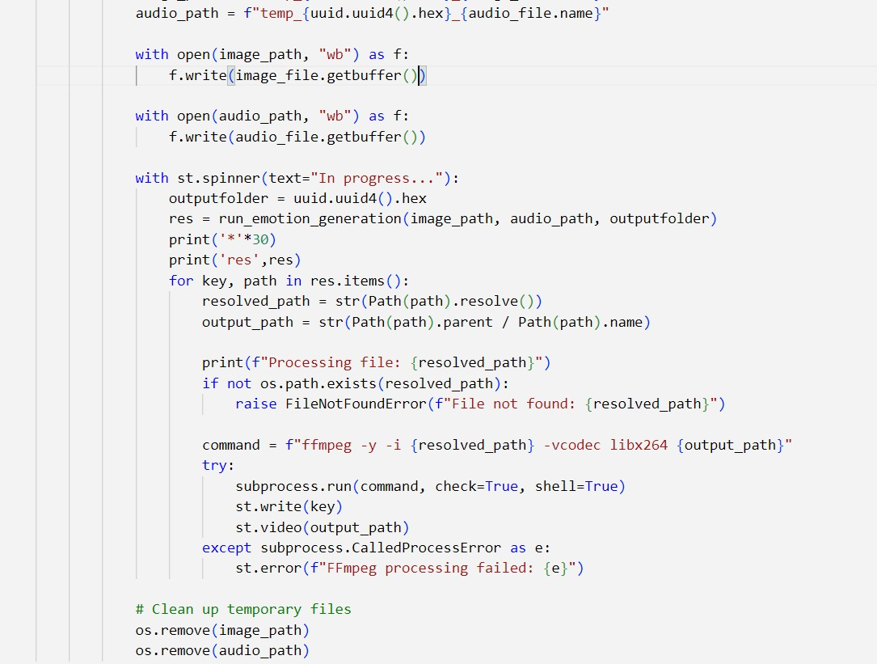

Slide 16
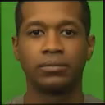
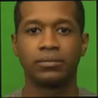
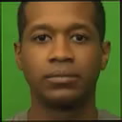


ANGRY:
SAD:
NEUTRAL:
FEAR:
HAPPY:

Slide 17


Slide 18

PERFORMANCE AND EFFICIENCY
Accuracy: The model achieves 94.9% accuracy for clear facial expressions but struggles with subtle ones like fear vs. surprise.
Precision and Recall: High for happy and angry faces, but lower for fear and sadness due to similarities in these expressions.
Processing Speed: 25-30 fps in real-time applications with optimized architectures (MobileNet, EfficientNet) for fast performance.
Memory Usage: Under 2GB GPU memory during inference, suitable for mobile and embedded devices.
Inference Time: Under 200 milliseconds per image, ensuring smooth interactions.
Efficiency Trade-Offs: Quality improvement may slow down processing, especially for complex expressions like surprise.

Slide 19
CHALLENGES AND LIMITATIONS
Expression Ambiguity: The model struggles with differentiating between similar facial expressions (e.g., fear vs. surprise), leading to lower accuracy in subtle emotion classification.
Dataset Bias: The model may be biased toward certain demographic groups (e.g., age, ethnicity) if the training dataset lacks diversity, leading to poor generalization for underrepresented groups.
Real-Time Constraints: Despite optimizations, the model can experience slowdowns when generating complex expressions or in high-resolution scenarios, leading to trade-offs between quality and speed.
Facial Identity Preservation: While identity is generally preserved, some facial features may be distorted during extreme expression modifications, especially for non-standard or rare emotions.
Generalization Across Different Devices: The model may perform optimally on high-end GPUs but could face challenges on devices with limited processing power or memory, affecting its scalability for mobile applications.

Slide 20
OVERALL IMPRESSION
Effectiveness: The model generates realistic facial expressions and works well for real-time applications, though it struggles with subtle emotions like fear and surprise.
Strengths:
High accuracy for clear expressions.
Real-time processing capabilities.
Identity preservation during expression changes.
Areas for Improvement:
Better differentiation of subtle emotions.
Bias reduction for diverse demographics.
More optimization for low-resource devices.
Future Potential: The model has great potential for applications in virtual environments, gaming, and entertainment with ongoing improvements in emotion classification and dataset diversity.

Slide 21
THANK YOU

